Slide 1
Control Software Summary

Slide 2
Overview
Pilot Interface
Overview
Interface Overview
Primary Flight Display
Hand Controls
Mission Control
Common Operating Picture
System Status
Sensor Control

Slide 3
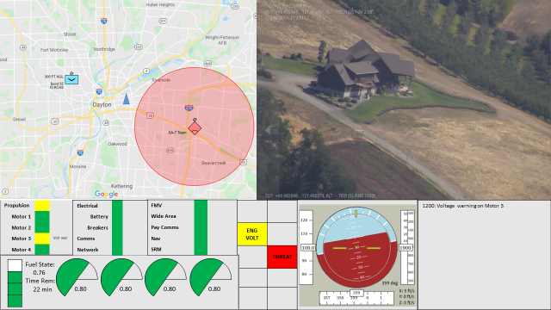
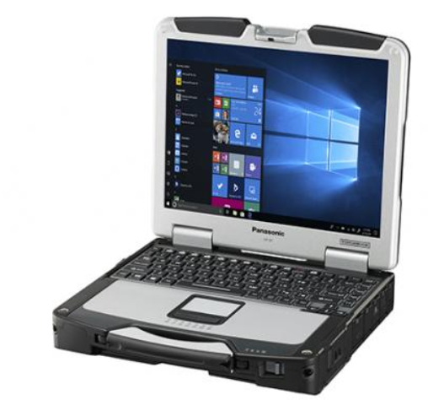
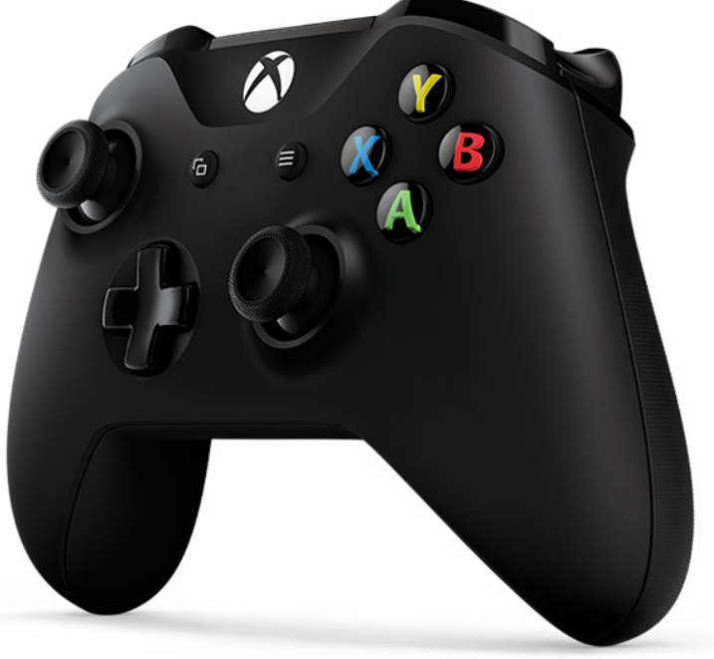
Pilot Interface Overview
Pilot interface executed from laptop
Controls all vehicle functions, including payloads
Primary pilot controls via COTS controller

Slide 4
Interface Overview
FMV / Imagery Display
Map Display
Health Monitor
Message Center
Cautions and Warnings
Primary Flight Display

Slide 5
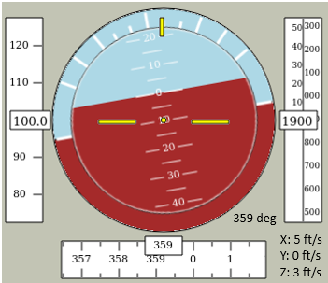
Primary Flight Display
Roll Angle
Airspeed
Altitude
Pitch Angle
Yaw Angle
Lateral Speed
Vertical Speed
Heading

Slide 6
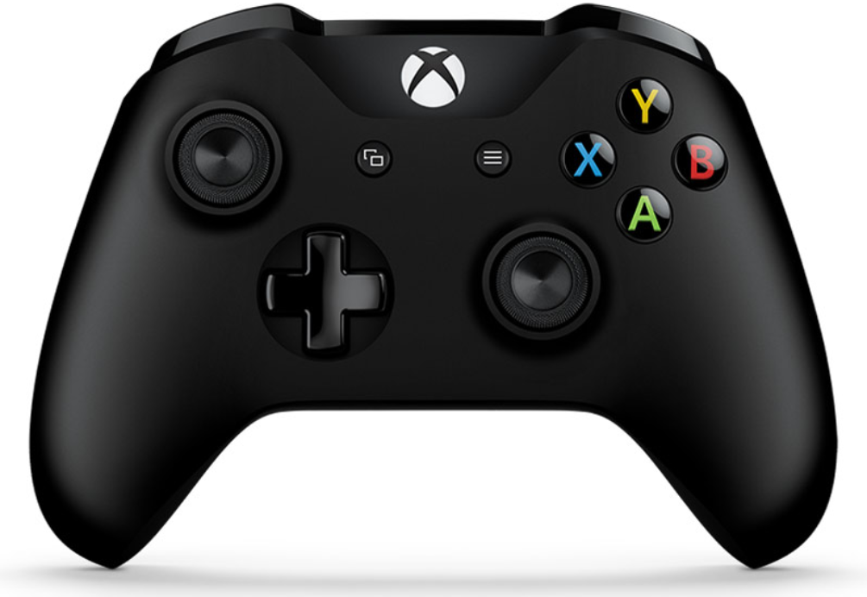
Hand Controls
Shoulder: Decrease Altitude
Trigger: Yaw Left
Select
Shoulder: Increase Altitude
Trigger: Yaw Right or Take Picture
Back
Lateral Velocity Controls
FMV Zoom Out
Open/Close Menu
FMV Zoom In
Menu Control Buttons
Roll / Pitch Angle Control
FMV Pan / Tilt (when FMV control is active)

Slide 7
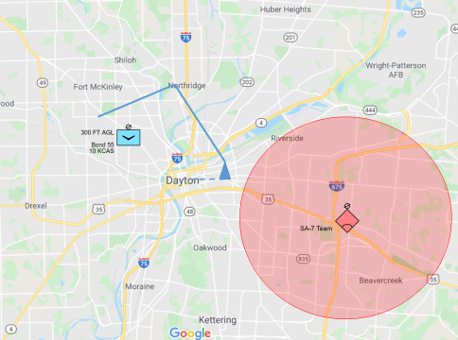
Common Operating Picture
Integrated map display and route planner
Map
Weather data
Threat data
Blue Force data
Available data will depend on external connections or organic sensors
Route Planner enables creation / management of autopilot routes
Can be externally built or locally built
Intuitive interface
Right click to add waypoint on cursor
Select a waypoint to edit

Slide 8
System Status Page
Health status shows the status of all system components
Each component can be turned on or off
Some can be reset or commanded to execute built-in-test
Page can also be used to adjust communications settings
Propulsion
Motor 1
Motor 2
Motor 3 |  | Volt wan
Motor 4
Electrical
Battery
Breakers
Comms
Network
FMV
Wide Area
Pay Comms
Nav
SRM
ENG VOLT
 | THREAT
Fuel State:
0.76
Time Rem:
22 min
0.80
0.80
0.80
0.80

Slide 9
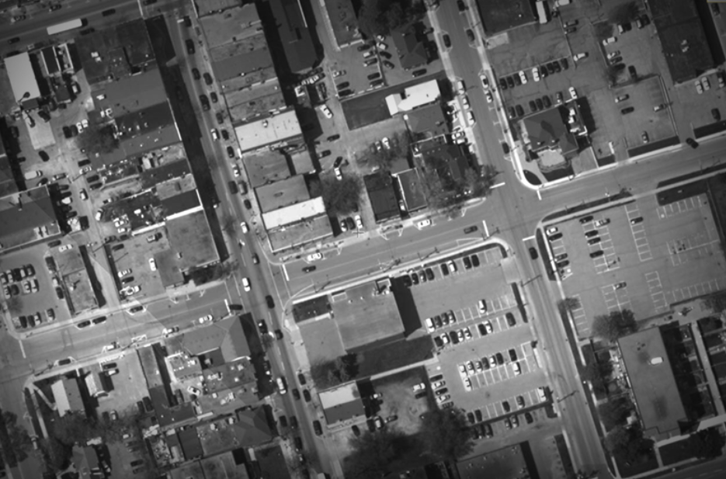
Sensor Controls
FMV
Controlled via primary controller
Simply push in Button 3 to enable control, then right stick pans and tilts camera
Zoom is executed via A and B buttons
The right trigger can be used to take a still image when the FMV control is enabled
Wide Area
Wide Area images are commanded via the menu
Pictures can be taken manually or automatically
[Manual] – Automatic – Settings
Press action button to take picture

